Slide 1

DO NOT RULE UP YOUR PAGE YET!
Put your thinking cap on!

Slide 2
DO NOT RULE UP YOUR PAGE YET!
Put your thinking cap on!
What is probability?
THINK – PAIR - SHARE

Slide 3
We are setting up a NEW section of your interactive notebooks for the next section!
From your last page of the measurement notebook skip one page and we will set up the new notebook.
You will have the page numbers start over again!

Slide 4
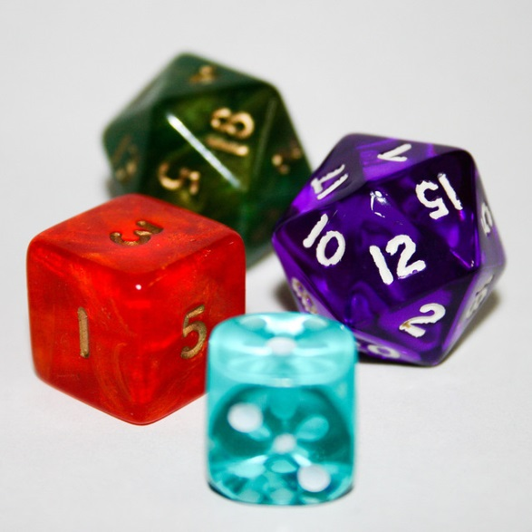

My Probability
Interactive Notebook
Name
Class
Teacher
Term 1 Semester 1
1

Slide 5
Contents
Glossary or Formula Page
Page
Date
Description
2
3

Slide 6
Tasks
24
7
30
Essential Question
Questions
Notes
Summary
4
5

Slide 7
24
7
30
Date
Title
EQ –

Slide 8

24
7
30
Date
Introduction to probability
EQ – What is the meaning of probability
The probability of an event is the chance of that event happening between 0 and 1. it can be written as words, a fraction, decimal or percentage.
What is probability?

Slide 9



What are some things that involve probability?
Gambling
Insurance
Weather Prediction
Coin tosses – sporting events

Slide 10
24
7
30
Date
Introduction to probability
EQ – What is the meaning of probability
What is the probability scale?
A probability scale, starting at 0 (impossible) and ending at 1 (certain).

Slide 11
Task : Create a Probability Scale
Draw this
Impossible
Even Chances
Certain

Slide 12
Task : Create a Probability Scale
Add the decimal values to each
A few have been done for you
Impossible
Even Chances
Certain
Decimal 0.0 0.4 0.6 1.0
We will go over all the answers at the end

Slide 13
Task : Create a Probability Scale
Add the fraction values to each
A few have been done for you
Impossible
Even Chances
Certain
Decimal 0.0 0.4 0.6 1.0
Fraction 0 $\frac{1}{5}$ $\frac{1}{2}$ $\frac{4}{5}$

Slide 14
Task : Create a Probability Scale
Add the percentage values to each
A few have been done for you
Impossible
Even Chances
Certain
Decimal 0.0 0.4 0.6 1.0
Fraction 0 $\frac{1}{5}$ $\frac{1}{2}$ $\frac{4}{5}$
Percentage 0% 20% 60% 100%

Slide 15
Task : Create a Probability Scale
Check Your Answers!
Impossible
Even Chances
Certain
Decimal 0.0 0.2 0.4 0.5 0.6 0.8 1.0
Fraction 0 $\frac{1}{5}$ $\frac{2}{5}$ $\frac{1}{2}$ $\frac{3}{5}$ $\frac{4}{5}$ 1
Percentage 0% 20% 40% 50% 60% 80% 100%

Slide 16
Exercise 3.1 page 34

Slide 17
Learning Logs

Slide 18
Notes Review
24, 7 ,30
Date
Title
Essential question
Notes complete
Notes complete with colour and diagrams
Questions completed
Contents page filled in
Formula page filled in

Slide 19
Homework
Review your notes and write a summary answering the essential question.

